Slide 1


Slide 2
Cyndee Haydon
2022 NAR Vice Chair, Insurance Committee
NATIONAL ASSOCIATION OF REALTORS®

Slide 3
AGENDA
Overview and Welcome
NFIP Legacy Insurance Rating System
New Risk Rating 2.0: Equity in Action
What Realtors® Need to Know & Resources
Thank you!

Slide 4
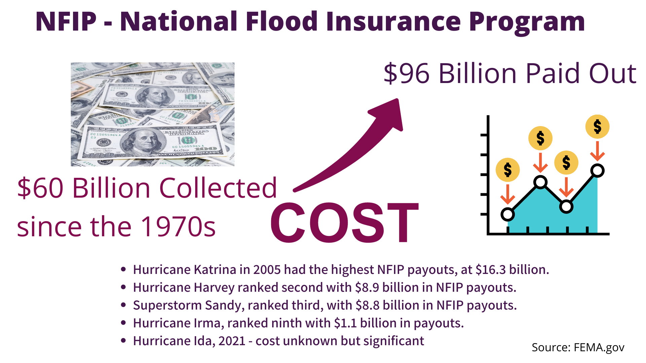

Slide 5
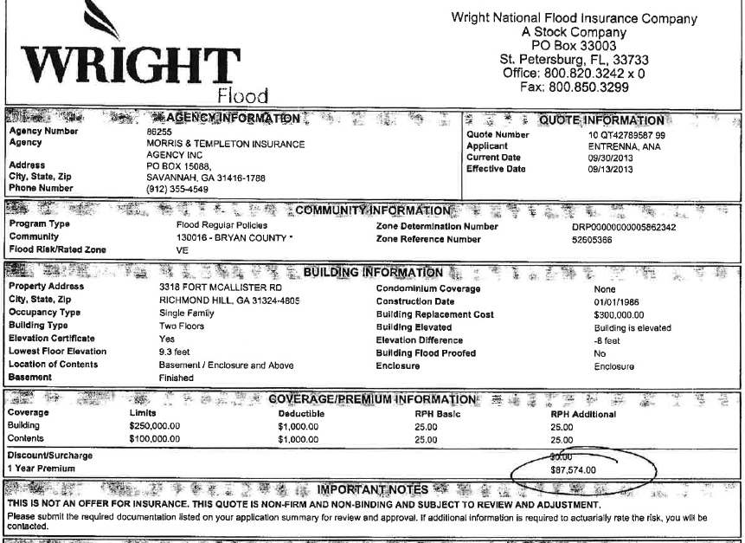


2012 Biggert-Waters Act Example

Slide 6
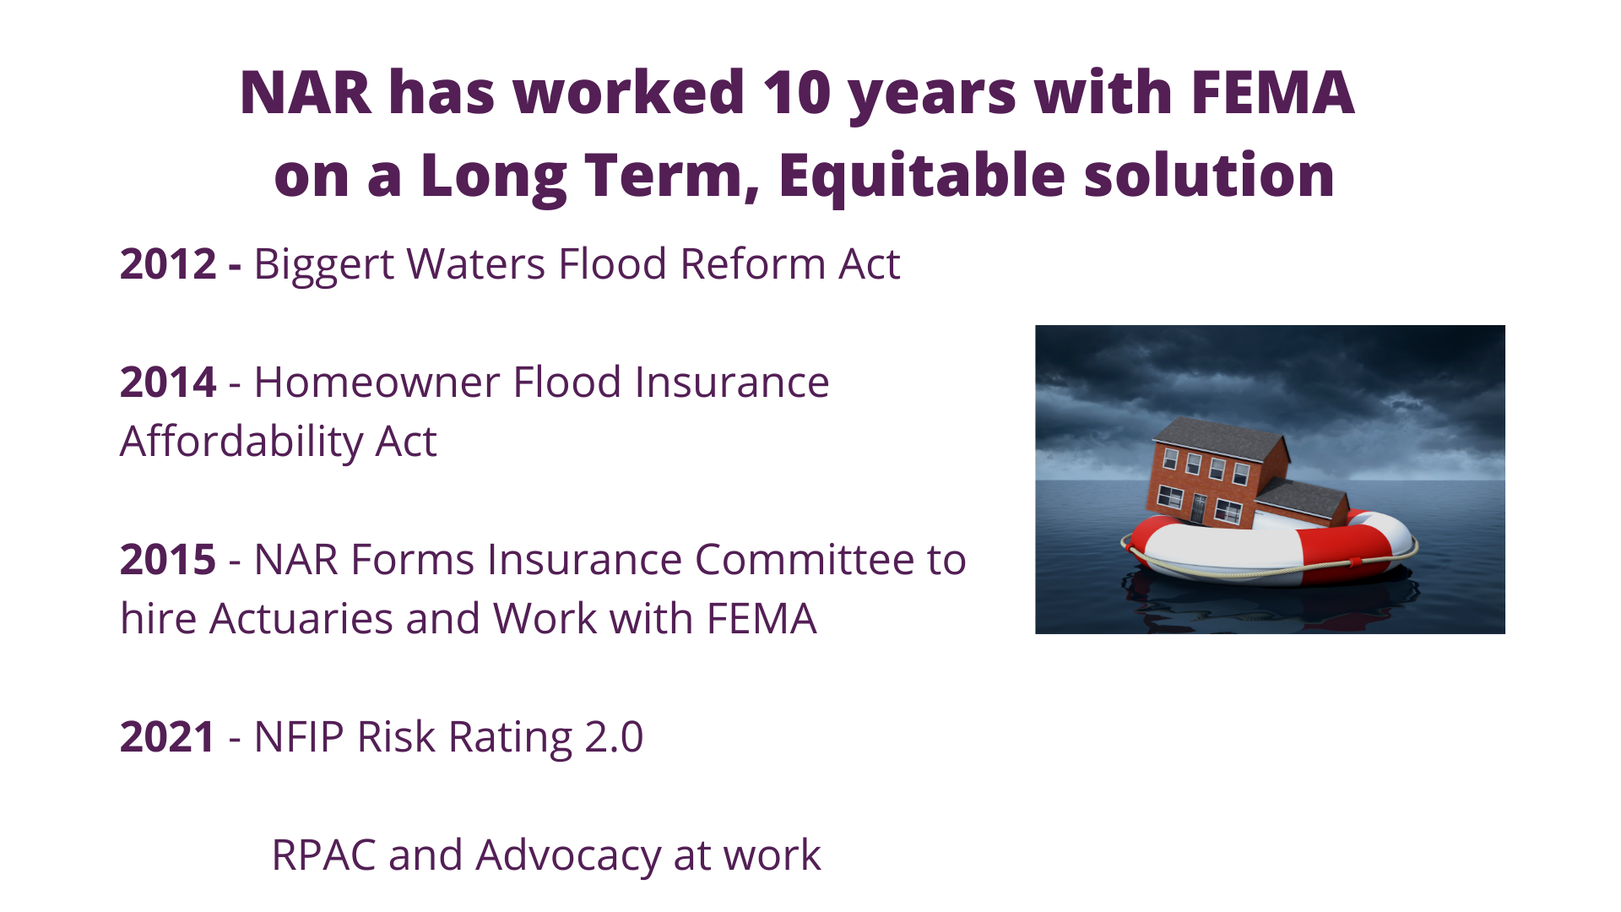

Slide 7
Austin Perez
NAR Staff Executive, Insurance Committee
NATIONAL ASSOCIATION OF REALTORS®

Slide 8
NFIP Legacy Rating System

Slide 9
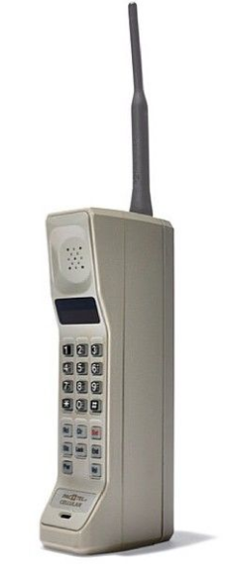
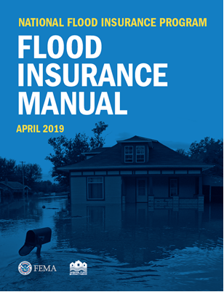
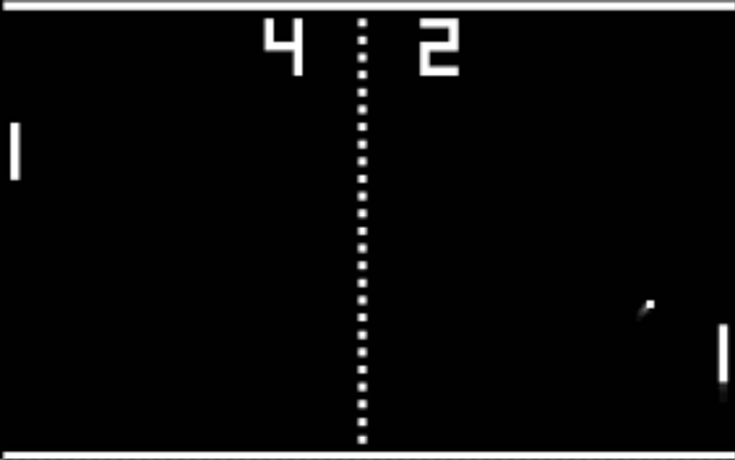
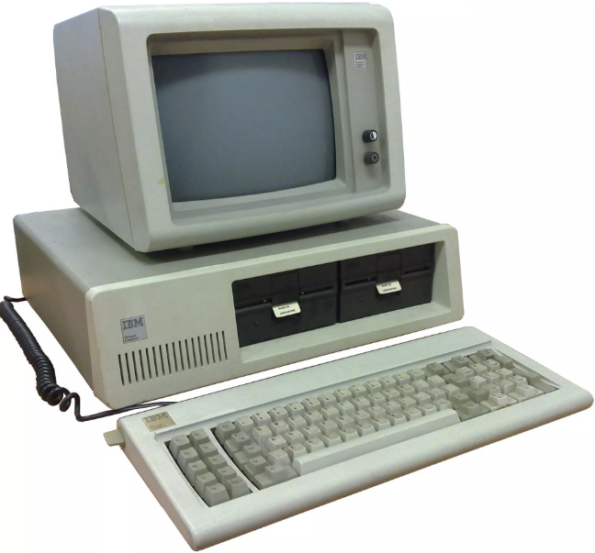
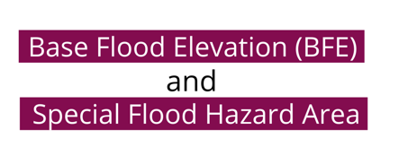
Problem 1: Current NFIP rates developed 50 years ago

Slide 10
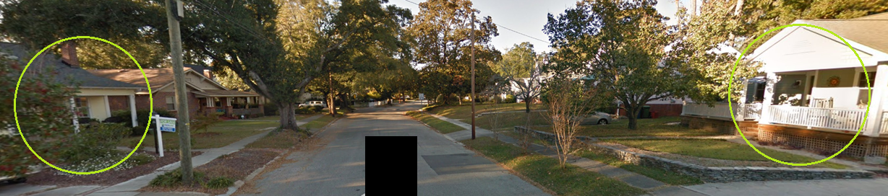
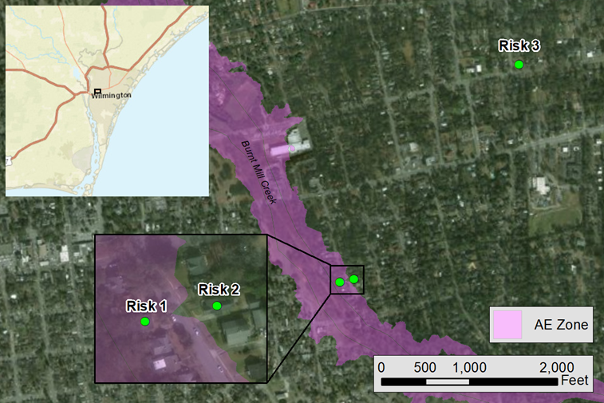
Problem 2: Neighbors with very different rates
Risk 1 $6,042
Risk 2 $400
Hypothetical, identical houses*
      Risk 1 near a creek
      Risk 2 across the street from Risk 1
      Risk 3 far away from the creek
Current NFIP premiums:
      Risk 1: $6,042
      Risk 2: $400
      Risk 3: $400
      Source: Milliman

Slide 11
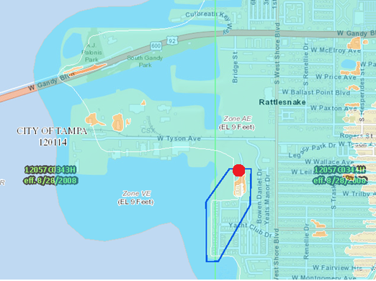
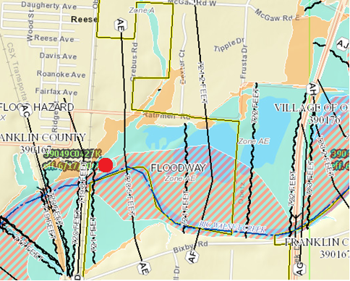
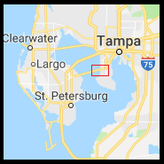
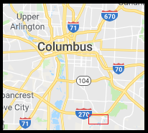
Problem 3: Many paying more than their share of the risk
Homes in same zones are subject to same rates across states
AE zones in coastal Tampa and Columbus, OH
Identical houses at these locations
      One-story, frame house worth $250k
      First floor 1 foot above base flood elevation
      No basement, built 1990
Source: Milliman

Slide 12
NFIP Risk Rating 2.0

Slide 13

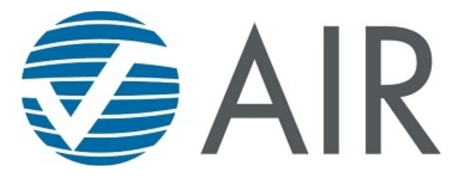





Risk Rating 2.0 is product of collaboration and science
TIME: Research, design, analysis, development, and testing translates to 5+ years of work and thousands of hours.
PEOPLE: The cross-functional team of 20+ NFIP program experts, including 8+ full-time actuaries, collaborated with a diverse network of experts from a wide range of disciplines:
  Academics
  Actuaries
  Building scientists
  Engineers
  Insurance industry experts
  Mappers
  Underwriters
  Mitigation experts
TECHNOLOGY: Cutting-edge technology and best available data used to make a modern-day program:
Private Sector
Rate Setting Methods
Private Sector
Catastrophe Models
Government Models, Available Data, and Collaborations
Source: FEMA

Slide 14
Risk Rating 2.0 prices individually rather than by flood zone
Risk Rating 2.0 Methodology*
Current Rating Methodology
FEMA-sourced data
FEMA-sourced data
Additional data sources: Federal government-sourced data, commercially available third-party
Rating Variables
Flood Insurance Rate Map Zone
Base Flood Elevation
Foundation Type
Structural Elevation (Special Flood Hazard Area Only)
Cost to Rebuild
Rating Variables
Distance to Coast/Ocean/River
River Class
Flood type — Fluvial/Pluvial
Ground Elevation
First Floor Height
Construction Type/Foundation Type
1% Annual Chance of Flooding (Frequency)
Fees and Surcharges
Broader Range of Flood Frequencies
Fees and Surcharges
Source: FEMA

Slide 15
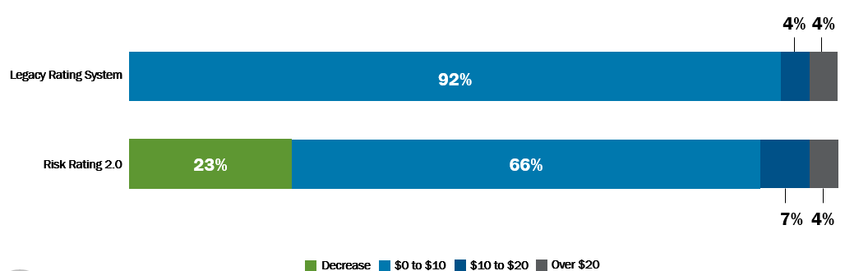
Risk Rating 2.0 adopts industry technologies & standards
Methodology | Single-Family Home Maximum Policy Cost*
Current Rating Methodology | $45,925
Risk Rating 2.0 | $12,125

Slide 16
Cyndee Haydon
2022 NAR Vice Chair, Insurance Committee
NATIONAL ASSOCIATION OF REALTORS®

Slide 17
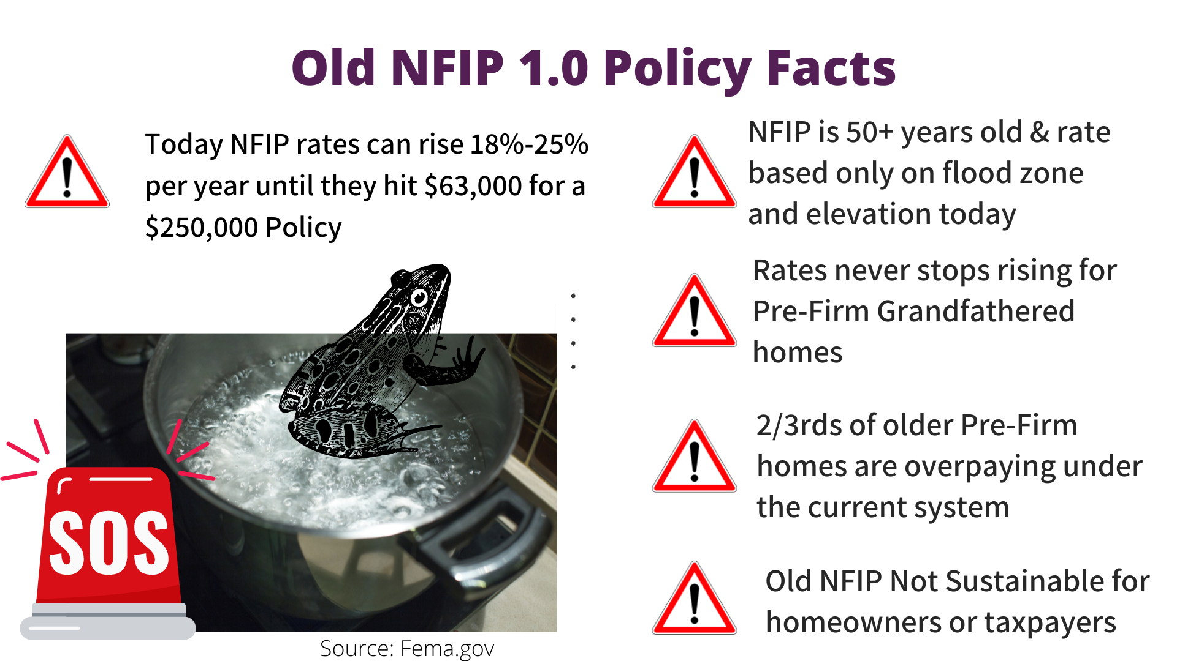

Slide 18
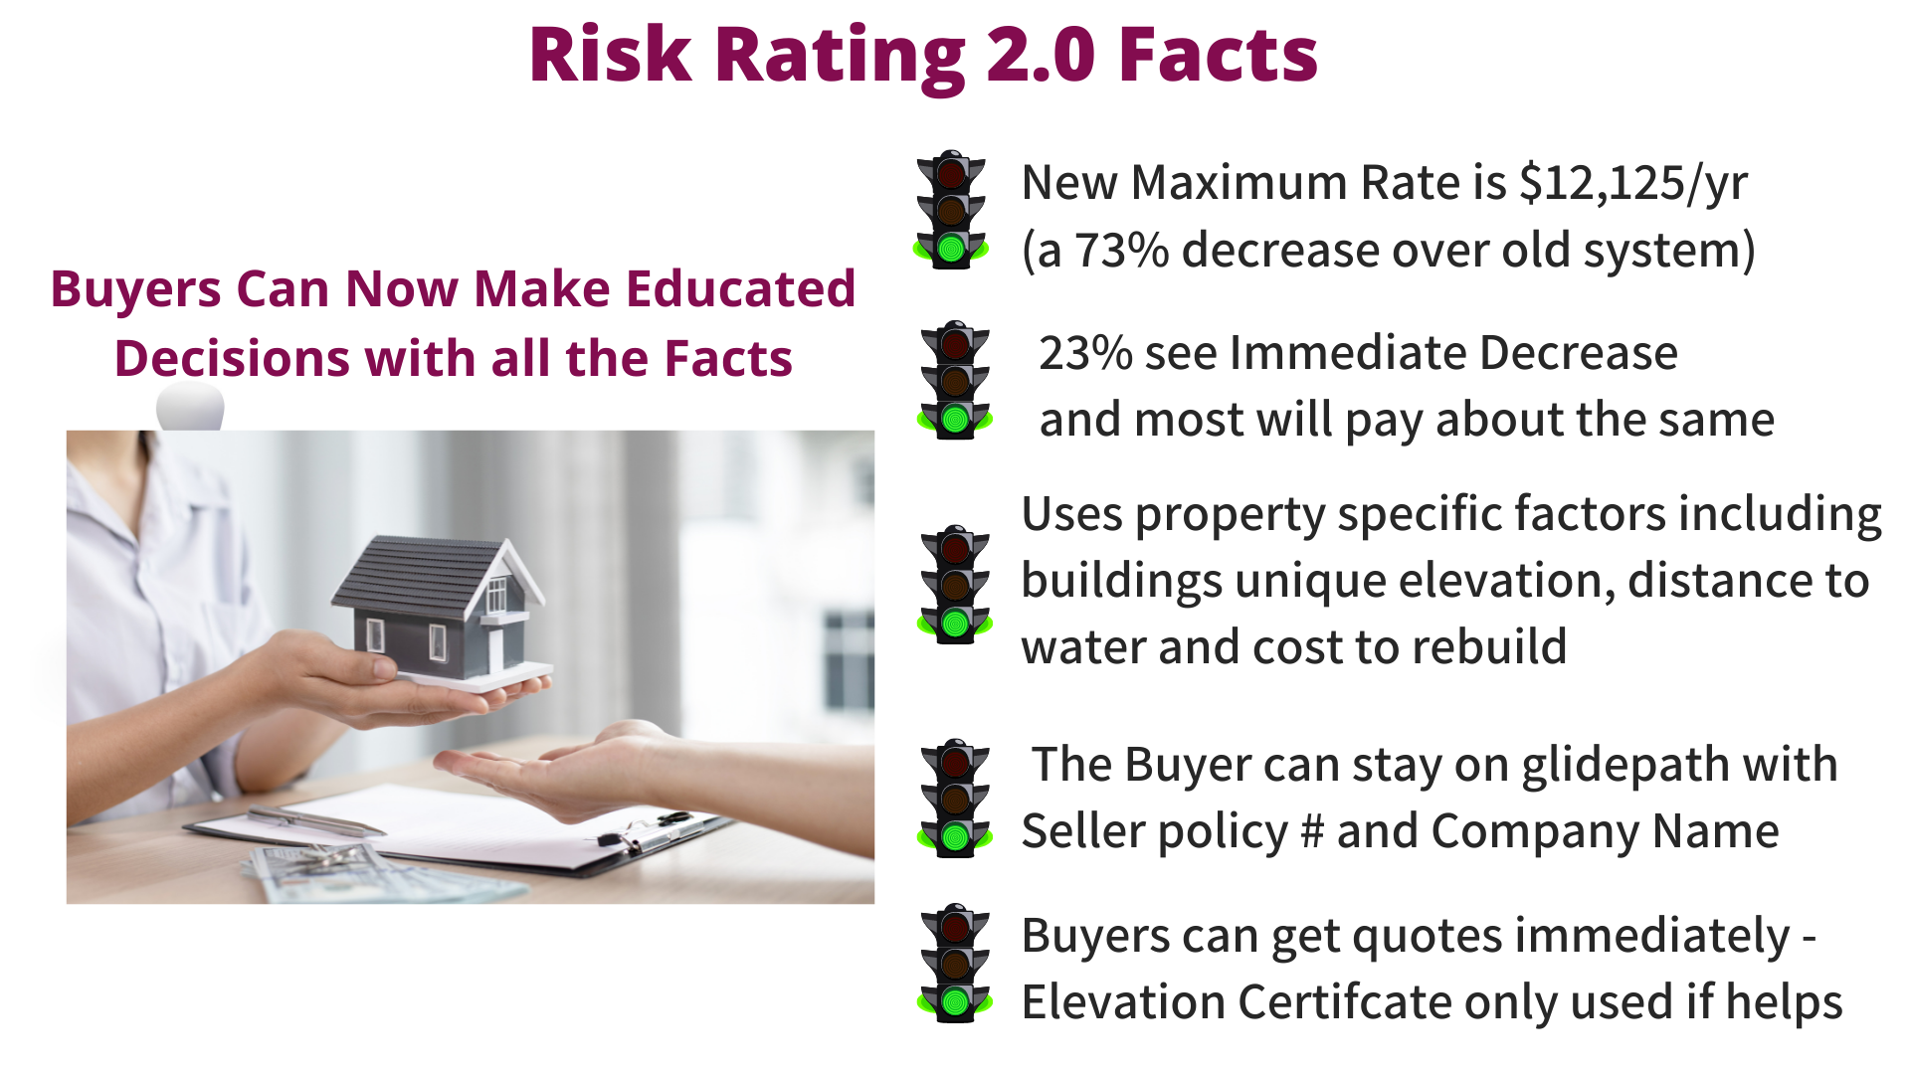
Source: FEMA

Slide 19
What’s Not Changing
Residential & Commercial Policy Coverage stays the same
Buyer can still assume/transfer the Seller’s policy so no big jumps on day 1.
Still have 18% or 25% maximum increases for existing policies when transferred
Still required to have flood insurance if in a Special Flood Hazard Area like AE & VE and have a federally backed mortgage
Community Rating System (CRS) discounts of 5-45% still apply
Elevation certificates are now optional and can be used if it will help get more favorable rates
Source : FEMA

Slide 20
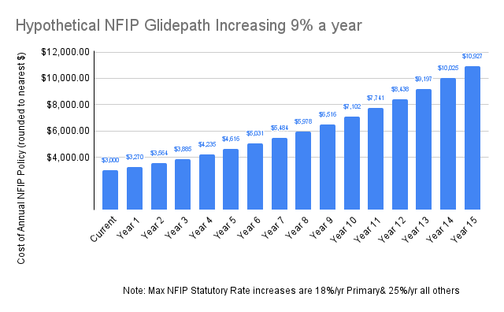

Slide 21
Rate Comparison: Lower Value Coastal
LEGACY
Date of Construction 1986
VE Flood Zone
Slab
3 floors
Premium $474
RR 2.0
RCV $395,593
Premium $893
GLIDEPATH

Slide 22
Rate Comparison – Severe Repetitive Loss (SRL)
LEGACY
Date of Construction 1977
AE Flood Zone
Slab
1 floor; 1456 sq ft.
Premium $7,280
RR 2.0
RCV $229,323
Premium $1,978

Slide 23
Rate Comparison – High Value Coastal
LEGACY
Date of Construction 1967
AE zone 100 feet from VE
Slab
Pre-FIRM
Premium $2488
RR 2.0
Last sold for $1.5 million
Premium $7,669
GLIDEPATH

Slide 24
Rate Comparison – Inland Riverine
LEGACY
Date of Construction 1900
AE zone
Slab
1 floor; 956 sq ft
Premium $5,958
RR 2.0
RCV $200,000
RR 2.0 Premium $1,547

Slide 25
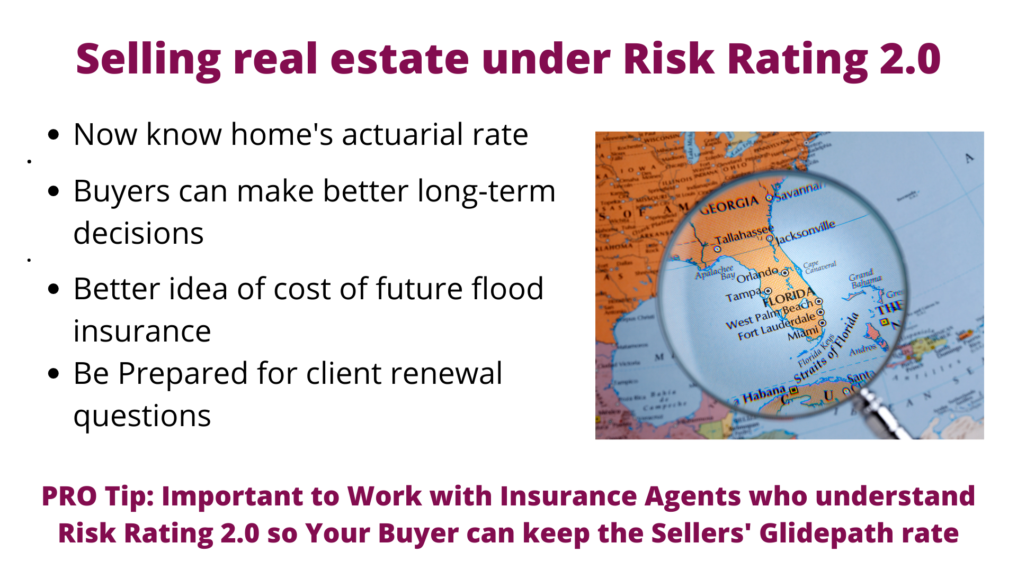

Slide 26

TRANSITIONS TYPICALLY MESSY AND NOISY!
Pause – Breathe – Get the Facts!

Slide 27
What Realtors® Need To Know
Prepare your clients that change is coming
Utilize NAR resources provided - Handout NAR FEMA flyer to clients
Be their calm professional … Pause – Breathe – Get the facts
Encourage clients to start early and work with experienced, knowledgeable flood insurance agents to understand process and all their options.
Don’t assume - remember your license and training
Make sure you have a knowledgeable Insurance Advisor on your team.

Slide 28
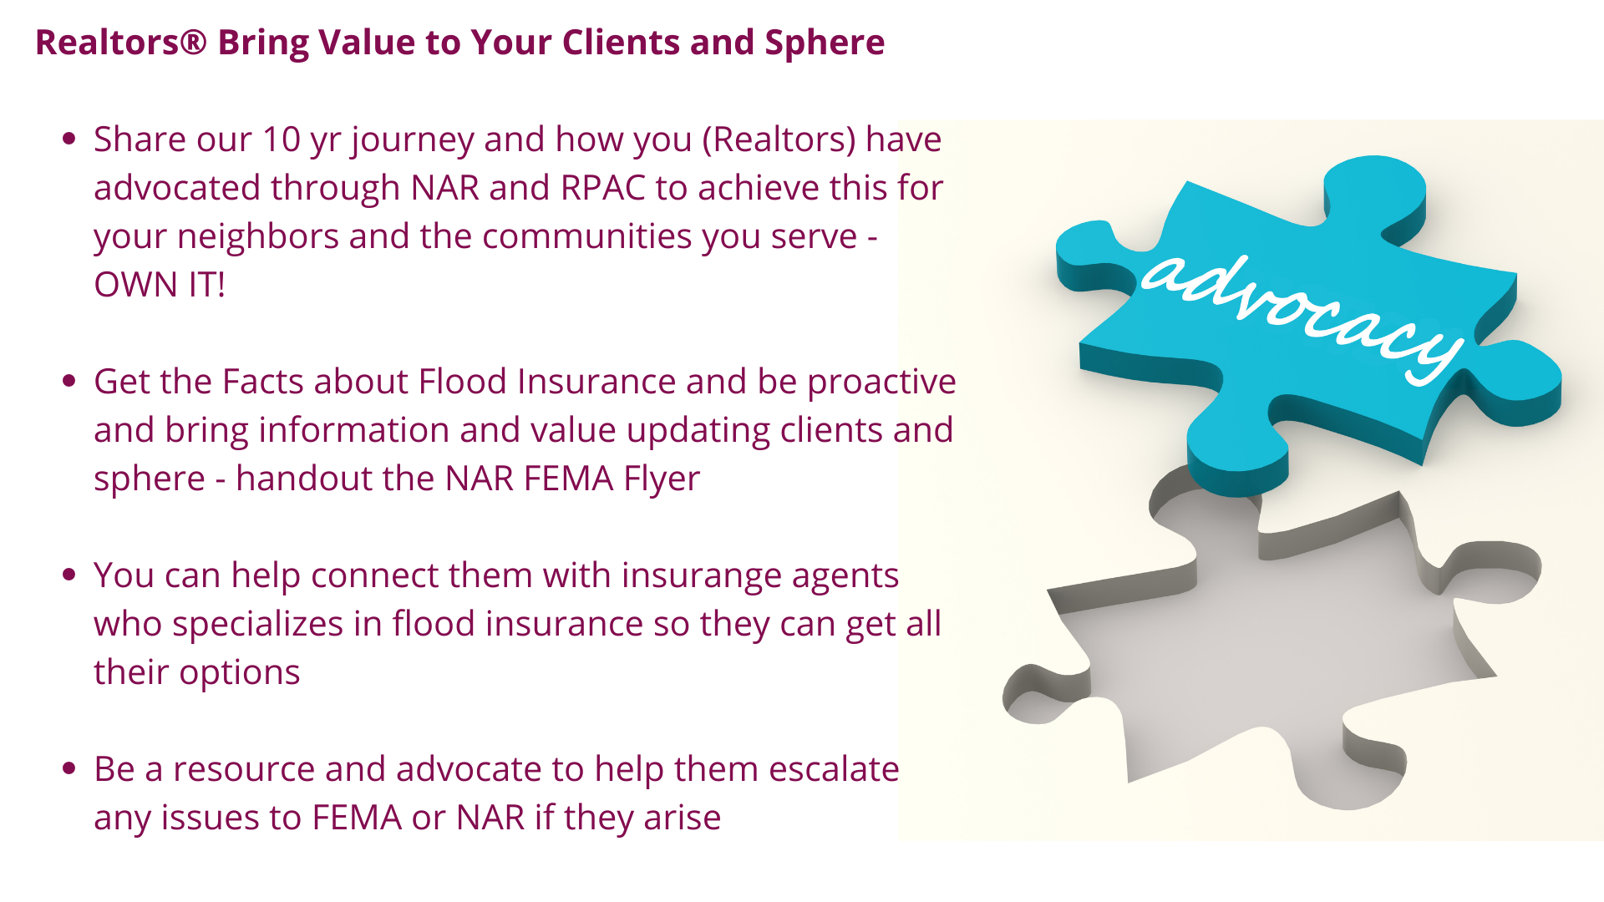

Slide 29
NAR Resources for You
NAR Member Information Packet https://www.nar.realtor/national-flood-insurance-program/fema-risk-rating-2-0-equity-in-action
FEMA-NAR Flyer for Homeowners https://www.nar.realtor/national-flood-insurance-program/major-improvements-coming-to-the-national-flood-insurance-program
NAR Frequently Asked Questions (FAQs) https://www.nar.realtor/national-flood-insurance-program/faq-fema-risk-rating-2-0-townhall
NAR Member Legal Guidance https://www.nar.realtor/flood-insurance#section-166024
Video: FEMA Risk Rating 2.0: A modern equitable flood insurance system https://www.nar.realtor/videos/risk-rating-2-0-part-1-a-modern-equitable-flood-insurance-system
Video: FEMA Risk Rating 2.0: The Impact on Your Business https://www.nar.realtor/videos/risk-rating-2-0-part-2-impact-on-your-business
Video: NAR-FEMA Townhall https://www.nar.realtor/videos/nar-town-hall-featuring-fema-senior-executive-david-maurstad

Slide 30
Questions?
Austin Perez
Senior Policy Representative – Insurance
National Association of REALTORS®
APerez@nar.realtor

